Slide 1


ASP.NET MVC: The Good Parts
Jess Chadwick
weblogs.asp.net/jesschadwick
jesschadwick@gmail.com

Slide 2

MARQUEE SPONSOR

Slide 3

PLATINUM SPONSOR

Slide 4

PLATINUM SPONSOR

Slide 5

PLATINUM SPONSOR

Slide 6




GOLD SPONSORS

Slide 7




SILVER SPONSORS

Slide 8
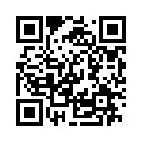
Follow Along!
(Or come back later)
goo.gl/J7G0A
(https://github.com/jchadwick/AspNetMvc-TheGoodParts)

